Slide 1
CYBERSECURITY BASIC
Jonathan D. Quirimit
MISD – ISA II
Notes:
Isang mapagpala at ligtas na umaga po sa ating lahat. Ang ibabahagi ko po ngayong umaga may kaugnayan sa ating seguridad, seguridad ng ating mga digital at electronic information.. In fact, ito ay isa sa mga napakaimportanteng matutunan natin sa panahon ngayon. Napakahalaga po nitong topic na ito lalo na sa panahon ngayon na kaliwa’t kanan ang mga hacking, scamming at data breach incidents hindi lng sa Pilipinas kundi sa buong mundo.
Ako nga po pala si Jonathan Quirimit, ang magbibigay ng awareness lecture sa inyo nga umaga with the title CYBERTHREAT BASIC.

Slide 2
Objectives:
What is Cybersecurity?
Understanding the importance of Cybersecurity
Understanding the Cybersecurity Threat Landscape
Commonly used Cybersecurity Threats
Notes:
Before we start our awareness lecture, tingnan muna natin ang mga objectives natin sa ating topic.
The objectives of this awareness lecture are, number 1………
What is cybersecurity? Ano ang ibig sabihin nito at para saan ba ito.
Understanding the importance of Cybersecurity… at kung bakit napakahalagang maintindihan at matutunan natin ito lalo na sa panahon ngayon.
Understanding the Cybersecurity Threat Landscape
We will also explore some of the most dangerous and common types of threats
And the last one, how to protect yourself and NKTI against these threats.

Slide 3
What is Cybersecurity?
Refers to the practice of protecting computer systems, networks, software applications, and digital data from theft, damage, unauthorized access, or any form of cyberattack.
It encompasses a wide range of technologies, processes, practices, and measures designed to safeguard information technology (IT) assets and ensure the confidentiality, integrity, and availability of digital information.
Notes:
Bago natin alamin ang kahalagahan ng Cybersecurity, alamin muna natin kung ano ang ibig sabihin ng cybersecurity
What is cybersecurity?................................
The ultimate goal of cybersecurity is to protect digital and electronic assets, information and systems from various cyberthreats. Lalong lalo na huwag manakaw, mawala o masira ang ating digital information.

Slide 4
Importance of Cybersecurity?
Protects sensitive data
Prevention of Financial Loss
Business Continuity
Compliance and Legal Obligations
Prevention of Cybercrime
Protection of Critical Infrastructure
Preservation of Privacy
Notes:
Ngayon naman po, alamin nmn po natin bakit mahalaga ang cybersecurity. Ano nga ba ang naibibigay nito sa atin at sa NKTI.
These are some of the benefits of having a well implemented Cyberscurity.
Protects sensitive data
Cybersecurity safeguards sensitive information such as personal data, financial records, medical records, and intellectual property from unauthorized access, theft, or disclosure. Cybersecurity is also essential to maintain privacy and prevent identity theft, financial fraud, and even corporate espionage.
Prevention of Financial Loss
Cyberattacks, such as ransomware, financial fraud, and data breaches, can result in substantial financial losses for individuals and organizations. Effective cybersecurity measures can prevent or mitigate these financial risks.
Business Continuity
Cybersecurity ensures business continuity by preventing the disruption of business operations, leading to downtime, loss of revenue, and even reputational damage.
Compliance and Legal Obligations
Many industries like NKTI are subject to regulatory requirements and legal obligations related to data protection and cybersecurity like sa RA 10173, also know as Data Privacy Act of 2012. Failing to comply with these regulations can result in legal consequences and financial penalties.
Prevention of Cybercrime
Cybersecurity measures help deter and detect cybercriminal activities, such as hacking, identity theft, online fraud, and ransomware. It plays a crucial role in reducing cybercrime rates.
Protection of Critical Infrastructure
Essential infrastructure sectors, including energy, transportation, and healthcare, rely on secure systems to maintain operations. Cyberattacks on critical infrastructure can have severe consequences, including public safety risks.
Preservation of Privacy
Cybersecurity protects the privacy of individuals by preventing unauthorized access to personal information and communications. Privacy is a fundamental right that cybersecurity helps uphold.

Slide 5
Cybersecurity Threats Landscape
Refers to the current and evolving landscape of potential cyber threats, risks, and vulnerabilities that organizations, individuals and societies face.
Notes:
Sa cybersecurity, may tinatawag tayong Cybersecurity Threats Landscape. Ano nga ba ang ibig sabihin nito?
Cybersecurity Threats Landscape
Refers to the current and evolving landscape of potential cyber threats, risks, and vulnerabilities that organizations, individuals and societies face.
This describes the broad picture or overview of the potential cybersecurity risks and identified threats.
Dito ntin makikita ang lahat ng mga existing at mga possible future threats. Hamlimbawa, dati isa lng a phishing, pero ngayon andmi ng uri ng phishing tulad spear phishing, smishing at vishing.

Slide 6
Cybersecurity Threats
Cyberthreat Actors
Phishing
Ransomware
Social Engineering
Insider Threats
Notes:
Ano ano nga ba itong mga threats na ito sa cybersecurity?
Itong mga threats na ito ay ilan lamang sa napakaraming threats. Ito lng po muna ang pag-uusapan dahil sila yung mga pinakamapanganib at madalas gawin o gamitin ng mga masasamang loob. Ito rin ang madalas may pinakamalaking negative impact sa atin o sa Institusyon ntin.

Slide 7
Cyberthreat Actors
Often referred to as “threat actors,” are
individuals or groups that intentionally cause harm to digital devices or systems.
(e.g. hacker, hacktivist, insider threats)
Notes:
Cyber Threat Actors……
Sila po yung mga taong nagcacarry out ng mga attacks tulad ng hacking, phishing, ransomware at iba pa.
Take note po na hindi lahat ng hackers ay masama. In fact we have 3 types of hackers, white hat (or ethical hacker), black hat and gray hat.
Ano nga ba ang pwedeng gawin ng mga hackers or cybercriminals sa mga personal informations na nakukuha nila sa atin?
Hackers can sell your data to the dark web. (trivia: did you know that there a dark web version of facebook, cia, bbc, etc?)
Identity Theft – using victim’s credit card, taking loans in using the victim’s name. Remember Senator Gatchalian’s case? Someone hacked his credit card and made 1million peso worth of food purchase from Food Panda. That was last January 2021. 4 separate purchases were made as provided by the bank
Account Take over – hackers can change your password and will lock you out with your own account.
Phishing Attacks and Extortion
Stolen personal information can be used to harm companies such as NKTI by so called spear-phishing.
Ang mga sumusunod na slides ay mga patunay na maraming nangayayaring hacking incidents sa atin.

Slide 8
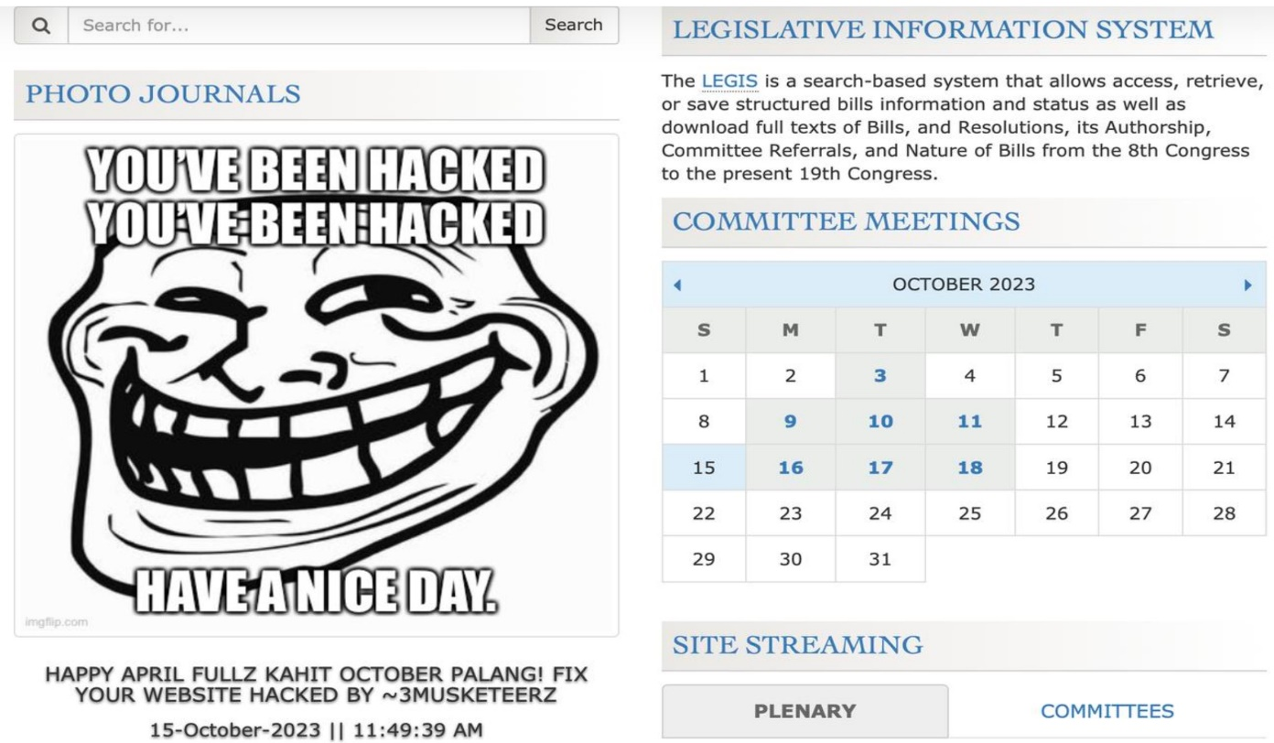
House of the Representative, 10-15-23
Notes:
The hacker defaced the website of the congress. This kind of attack is usually the works of what we call hacktivist or sometimes referred as gray hat hackers

Slide 9
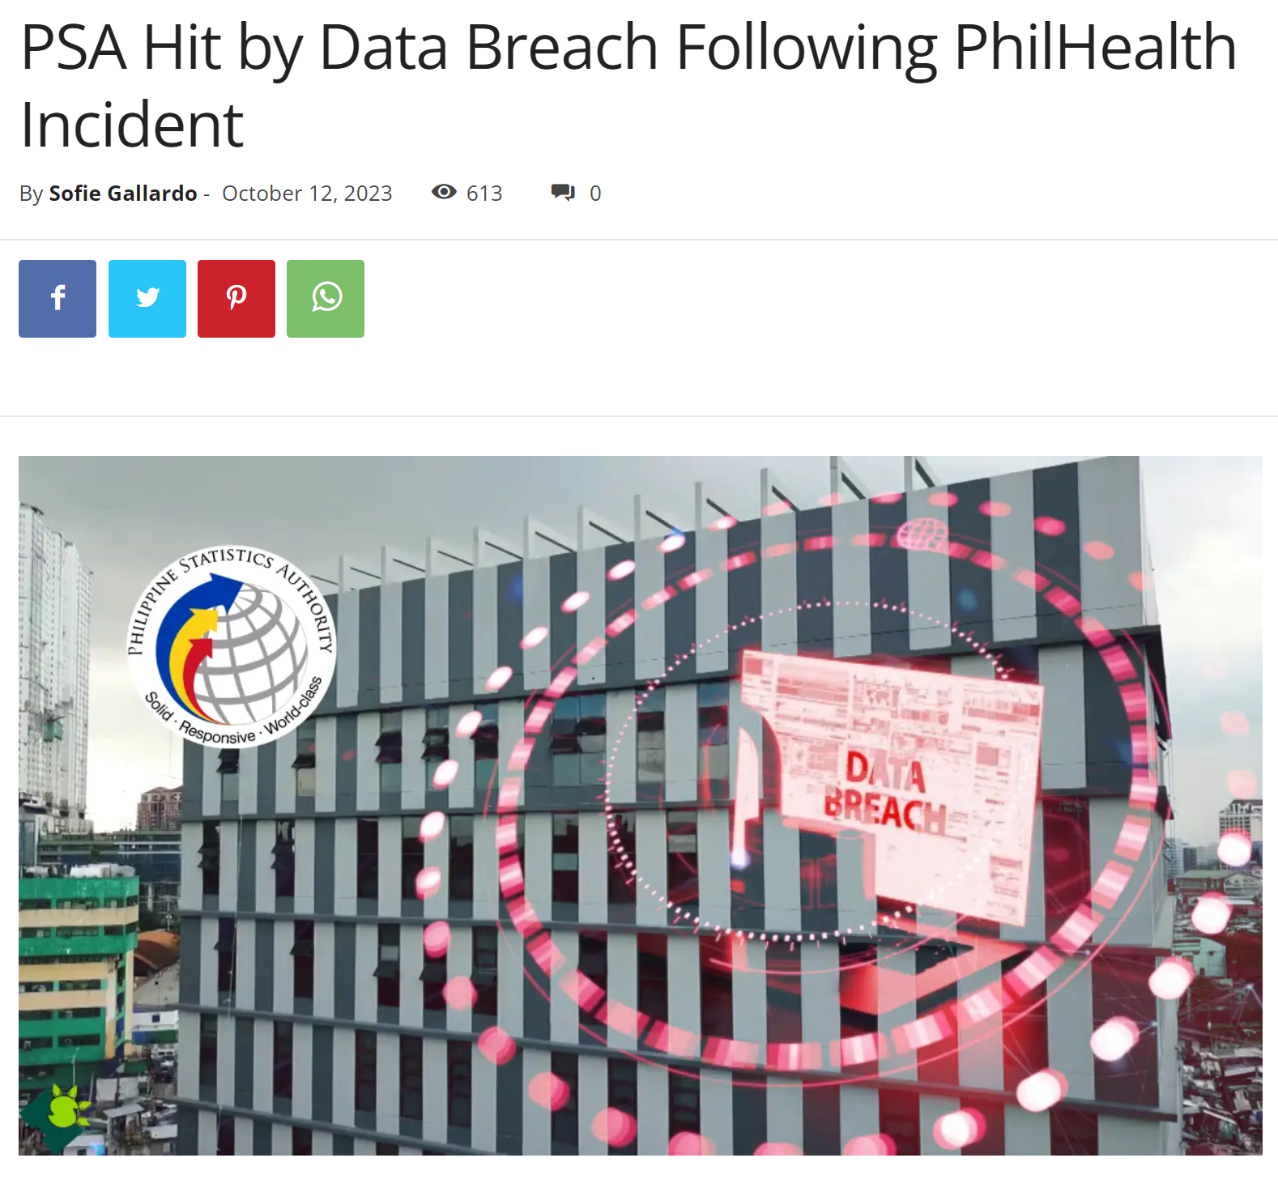
Philippine Statistics Authority, 10-11-23
Notes:
CBMS (Community-Based Monitoring Systems)– a tool used for poverty assessment and alleviation program

Slide 10
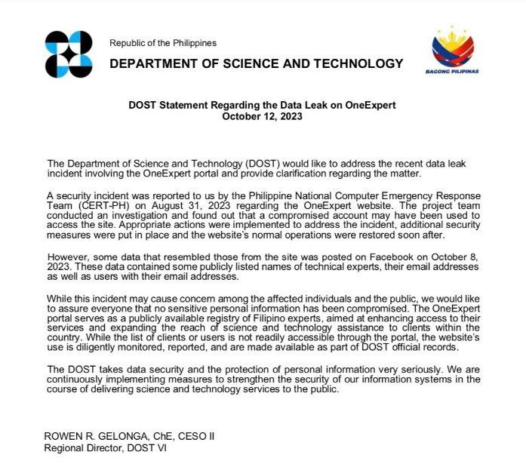
DOST’s OneExpert website, Aug. 31, 2023
Notes:
OneExpert is a publicly available registry of Filipino experts in the field of science and technology that provides assistance to their clients.

Slide 11
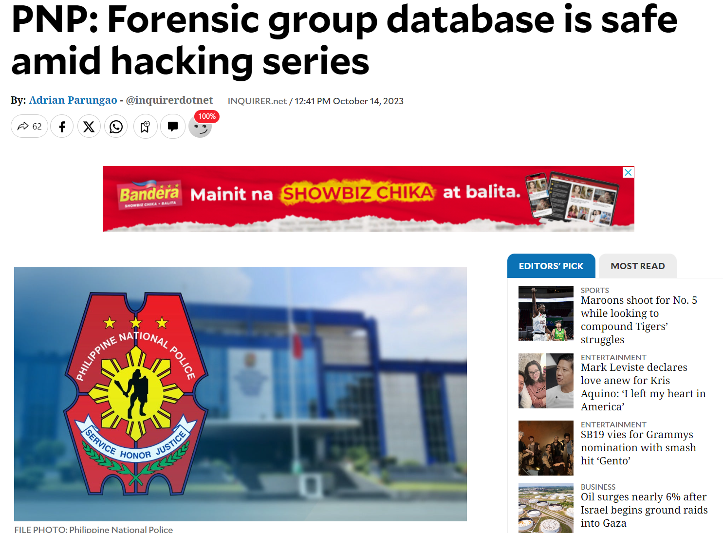
Philippine National Police

Slide 12
Phishing
Type of cyberattack that attempts to trick users into revealing sensitive information, such as login credentials, personal data or financial information.
(e.g. Email phishing, smishing, vishing, spear-phishing)
Notes:
Ngayon naman po dumako tayo sa isa pang threat, ang phishing.
Ano nga ba ang phishing?..............
Paano natin malalaman kung ang isang email or sms ay phishing?
Unsolicited messages
Generic Greetings
Sense of urgency
Misspelled Words and Grammar Errors
Fake Links– closely resembles the legitimate url
Attachments
Incentives and Promotions – prizes, discounts
Requests for Sensitive Information

Slide 13
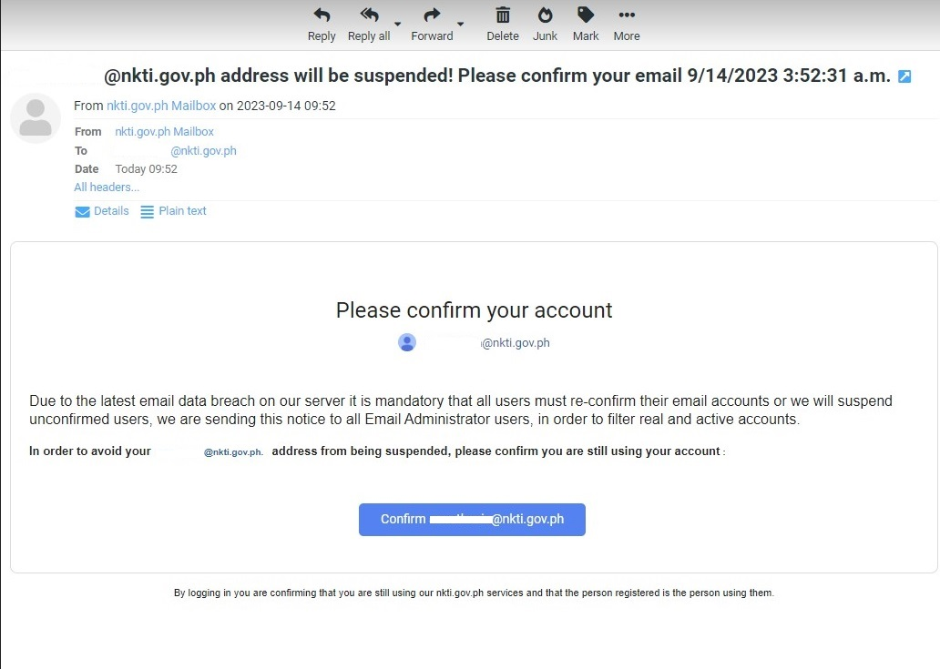
Email Phishing
Notes:
The following slides are just some of the examples of email phishing.
Sino sa inyo ang nakarecieve nito? Marami po kaming narecieve na mga ganitong email nitong mga nakaraang buwan.
Ito ay isang halimbawa ng spear-phishing.

Slide 14
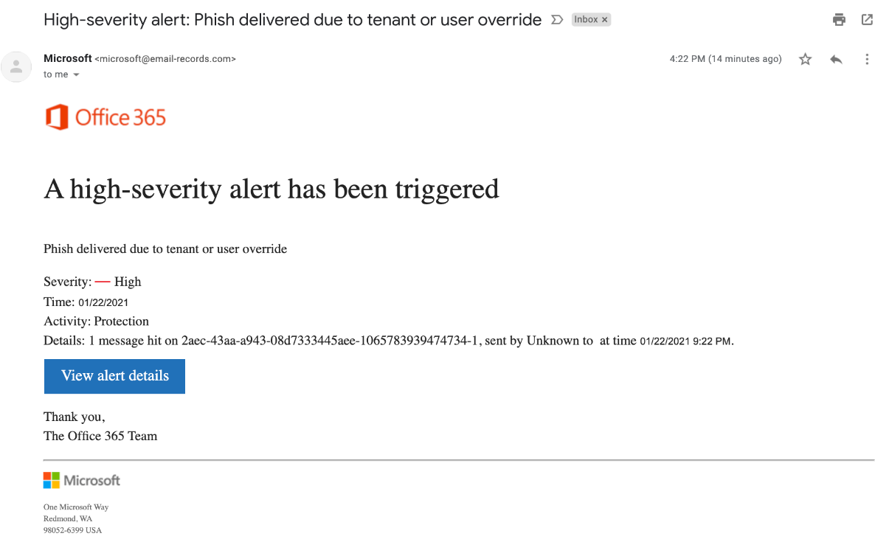
Email Phishing
Notes:
Eto naman po may sense of urgency.

Slide 15
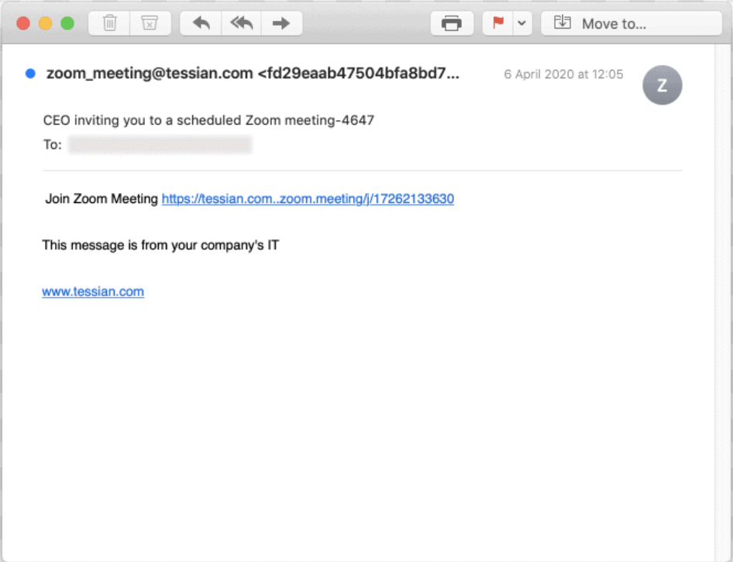
Email Phishing
Notes:
Eto pa po isa, pati zoom meeting zoom link ginagamit nila.

Slide 16
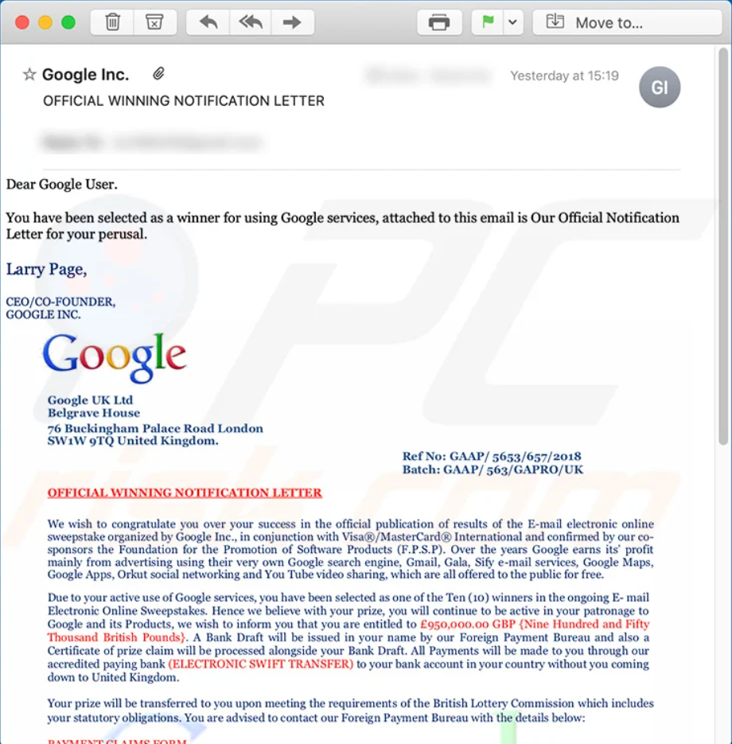
Email Phishing
Notes:
Ito naman po temang Incentive. Madalas may narerecieve tayong email o text messages na nagsasabing nanalo tayo kahit wala naman tayong sinalihan.

Slide 17
Ransomware
is a type of malware that encrypts a victim's data or locks a computer and demands a ransom payment in exchange for the decryption key
Notes:
Dumako namn po tayo sa isa pang uri ng Threat na mainit init pa na issue sa buong bansa.
There are actually 2 types of ransomware: Locker and Crypto
Question: Pano tayo posibleng mainfect ng ransomware? (eto yung tinatawag na common vector)
Answer: Isa sa pinaka common vector ng ransomware ay naggagaling sa email phising. Isa pang pang pwedeng panggalingan ay ang ang mga websites na maraming mga pop-ups at yung mga nag ooffer ng mga pirated softwares. Isa pa pong possibleng panggalingan ay ang mga porn sites.

Slide 18
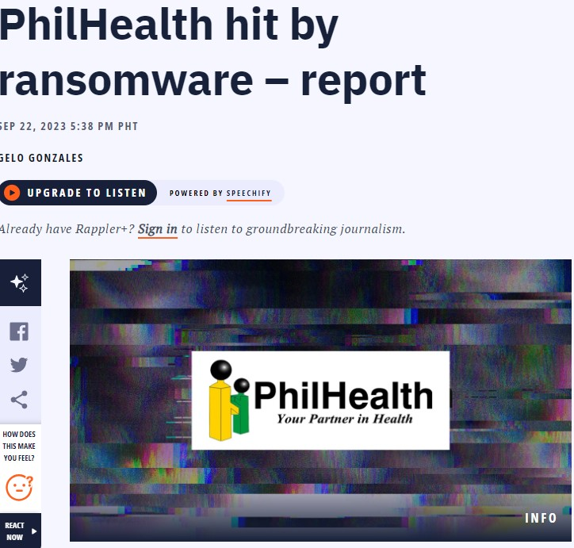
Medusa, 09-22-23
Notes:
Eto medyo fresh pa…….
They were recently attacked by Medusa Ransomware and demanded $300,000 of ransome. Pero nanindigan si philkealth at hindi nagbayad syempre kasi meron atang government policy na no ransom policy kaya yung data na nakuha ng mga hacker ay pinublish at available for download sa darkweb.
Ano ang isang tinitingnang dahilan bakit sila naransomware?
Kasi daw expired yung anti virus nila noong April pa. Isinisi p nga nila sa procurement nila kasi daw matagal yung process ng procurement.
Malaki ang pananagutan ni philhealth diyan under DPA of 2012 pag napatunayag mag negligence sila which is obvious naman kasi sa anti virus palang nila bagsak n agad. May balita p nga pati ung firewall ata nila expired din.

Slide 19
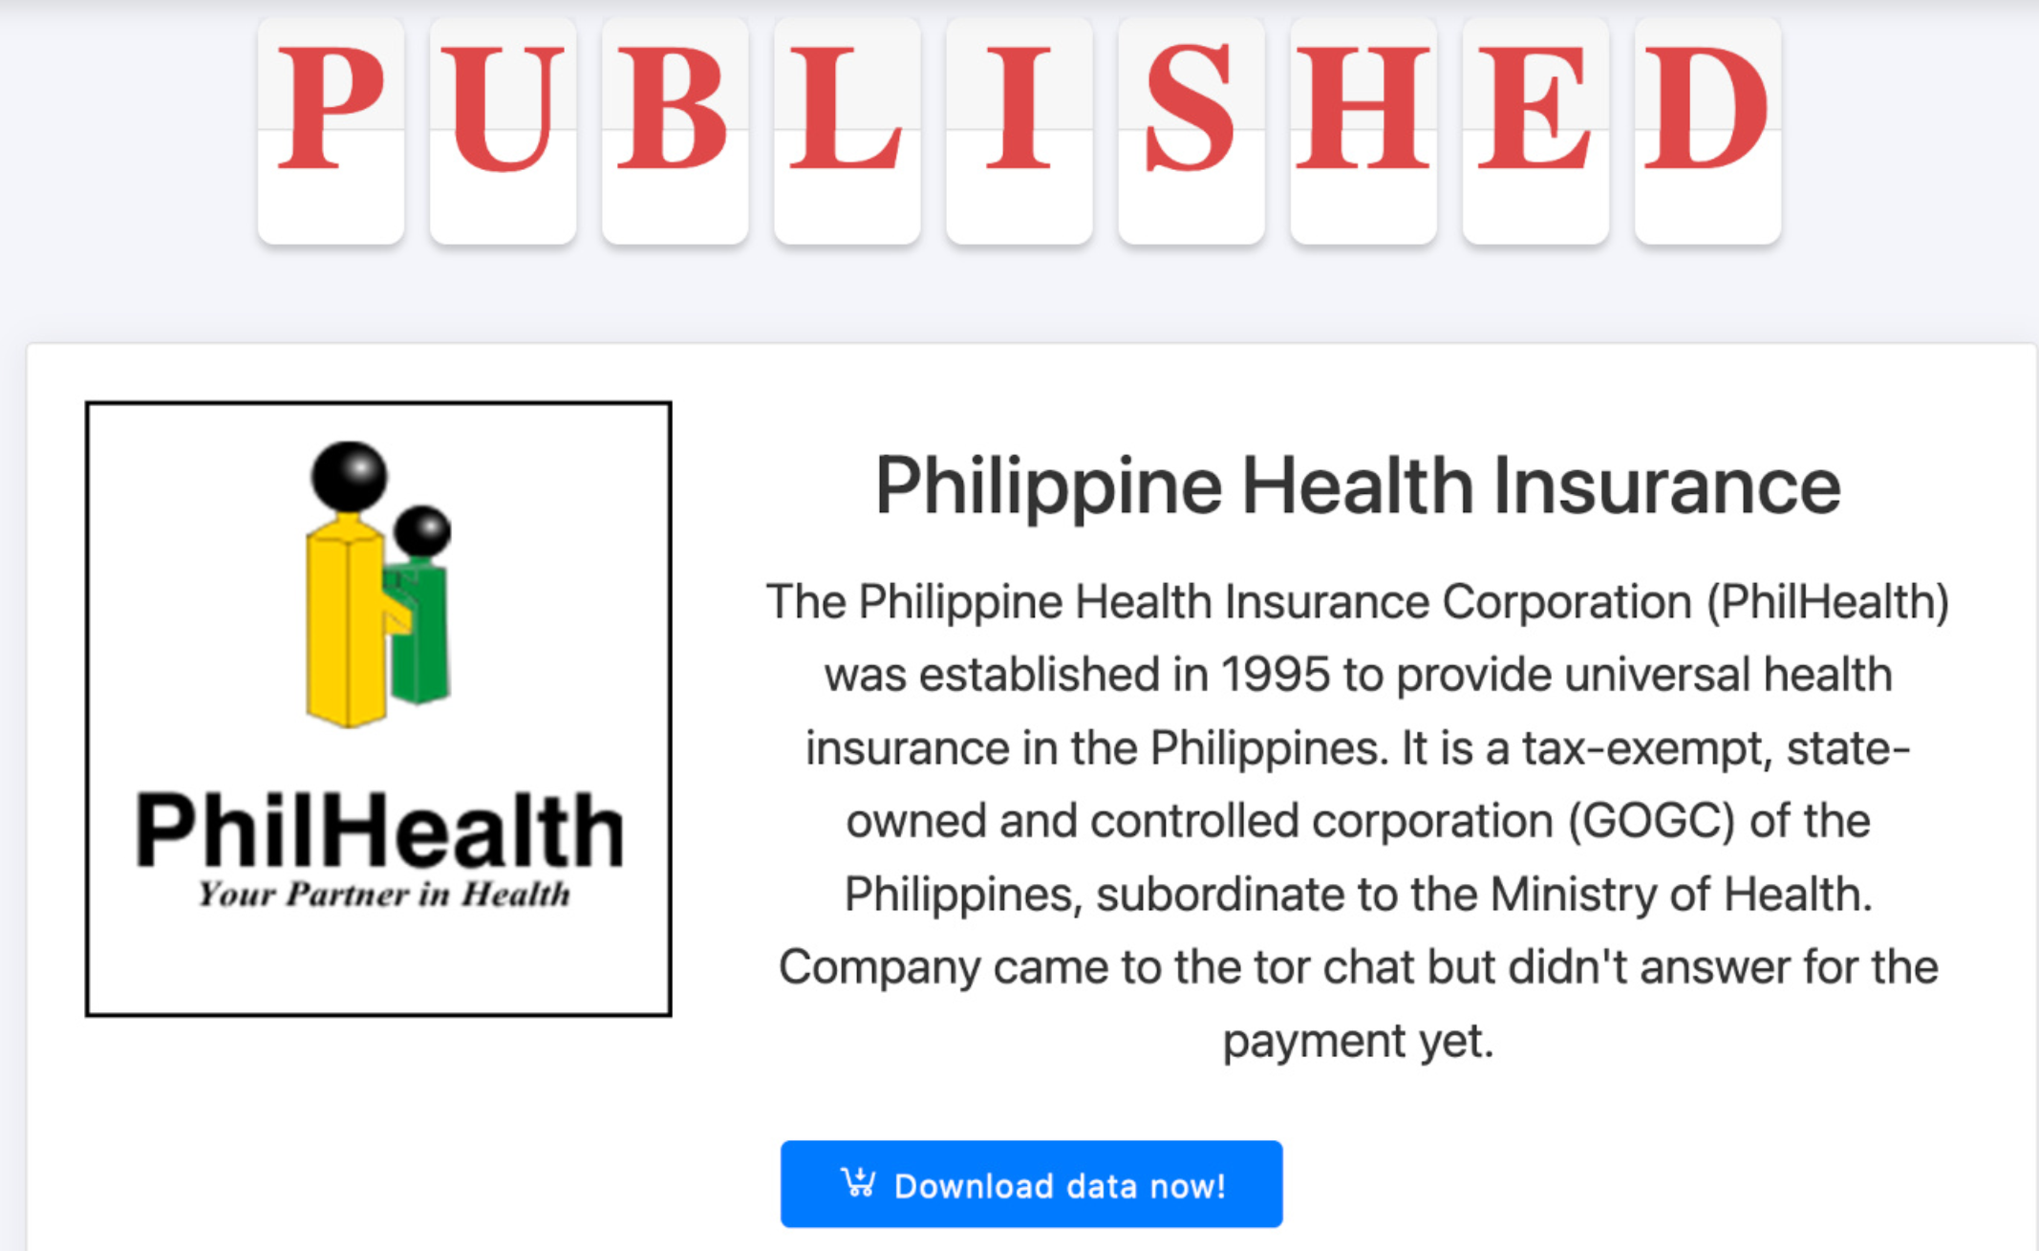
Medusa, 09-22-23
Notes:
Ayan, dahil di sila nagbayad pinublish nila sa darkweb.
Sino sa inyo dito may access sa darkweb? Joke lng po.
Wag nyo pong tatangkaing pasukin ang dark web kung hindi nyo po alam ang secure na pag access dahil baka bigla nlng may kumatok sa inyong taga NBI or PNP.

Slide 20
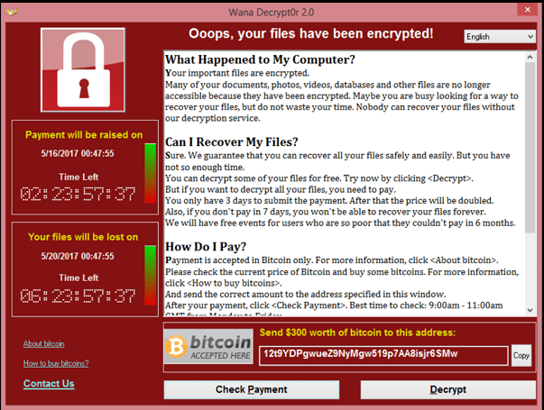
Wannacry May 2017
Notes:
Another example of a ransomware which has an estimated damage of $4 billion dollars worldwide is the wannacry.
This happened May 2017
This ransomware affected more than 200,000 computers in 150 countries worldwide. Isa sa napuruhan ng ransomware na to is yung National Health Service Hospitals ng United Kingdom specifically sa England and Scotland. Umabot sa 70,000 na devices tulad ng computers, MRI scanners, blood storage refrigerators at OR equipment ang naapetuhan. Halos magsara yung hospital dahil doon. Andami nilang hindi dinivert na mga ambulansya. Yung mga non-critical emergencies nga tinanggihan narin nila.

Slide 21
Social Engineering
is a type of cyberattack that exploits human psychology to trick people into revealing confidential information or performing actions that compromise security
(e.g. Phishing, Baiting)
Notes:
This type of exploit actually relies on deception.
Also, social engineering attacks exploits human vulnerabilities such as trust, curiosity, fear or the desire to help
They often target the weakest link in the security chain – people – rather than exploiting technical vulnerabilities.

Slide 22
Insider Threats
security risks that originate from individuals or entities within an organization
Notes:
These are threats within the organization. These maybe employees, contractors, partners, or other trusted insiders.
We are considered as an insider threats. Mamaya malalaman natin kung anong klaseng insider threats tyo.

Slide 23
Types of Insider Threats
Malicious Insider Threats
Unintentional Insider Threats
Notes:
We have 2 types of insider threats:
First is the Malicious Insider.
And the second is the unintentional insider.

Slide 24
Malicious Insider Threats
individuals who have malicious intent and already have access to a computer system or network
Notes:
What is a malicious insider?
These are the ones with malicious intent that can compromise our security. Pwede silang magnakaw ng data, mag-unauthorize access or pwedeng manabotahe, or pwede ring maglagay ng malware sa mga pc or network. Mahirap madetermine itong mga klaseng tao.
Example:
Disgruntled employee who steals customer data and sells it to a competitor
Contractor who installs malware on the network in order to steal information
Former employee who hacks the system for revenge purposes of being fired.
Second is the negligent insider. Sila nmn yung mga threat due to carelessness or lack of awareness rather than may malicious intent. Pwedeng sila ung maaring mabiktima ng email phishing attacks dahil sa kakulangan sa awareness or pwede ring mishandling ng data lalo na yung mga physical na data. Sana
Yung pangatlo naman ay yung tinatawag na Compromised Insider: sila yung mga tao na maaring nacompromiso ang kanilang mga credentials dahil maaaring biktima sila ng email phishing at maaring makapagbigay ng access sa system sa mga may masasamang intention.

Slide 25
Unintentional Insider Threats
individuals who pose a security risk without malicious intent.
Notes:
Sila nmn yung mga posibleng threat due to carelessness or lack of awareness. Pwedeng sila ung maaring mabiktima ng email phishing attacks or iba pang social engineering attacks dahil sa kakulangan sa awareness.
Example:
Accidental Data exposure, tulad ng sending of sensitive information to the wrong recipient. Siguro marami sa atin dito naexperience ma wrong send.
Failure to follow security policies or procecures.

Slide 26
Cybersecurity best practice
Strong, Unique Passwords
Two-Factor authentication (2FA)
Phishing Awareness
Email Safety
Physical Security
Social Media Caution
Incident Reporting
Notes:
These are some of the best practice para maging ligtas tayo sa cyberspace.
Strong, Unique Passwords: use strong, unique passwords for all accounts. Passwords should be complex, contain a combination of letters, numbers, and special characters, and should not be easy to guess. Consider using a password manager to generate and store passwords securely. Gumamit din po ng hiwalay na emai para sa personal at professional use. Hangga’t maari ibang ang gamit na email sa mga mga financial accounts at iba rin sa social media accounts.
Two-Factor Authentication (2FA): Enable 2FA wherever possible. This adds an extra layer of security by requiring a second form of verification, such as a code sent to a mobile device, in addition to a password. Yung facebook nyo ba naka on yung 2fa nya?
Phishing Awareness: Educate yourself about the risks of phishing emails and how to recognize them. Do not click on suspicious links, download attachments from unknown sources, or provide personal information to unknown parties. Katulad ng pag attend niyo nitong awareness lecture natin ngayon. At least mas nagiging aware tyo sa mga security threats.
Email Safety: Be cautious with email attachments and links. Don't open attachments or click on links from unknown sources. Verify the legitimacy of email requests for sensitive information. Pag duda kayo pwede nyong tawagan or contakin yung nagpadala sa inyo ng email para sure.
Physical Security: Lock computers and devices when not in use. Use screen locks and password-protected screensavers to prevent unauthorized access.
Social Media Caution: Be mindful of what is shared on social media. Avoid posting sensitive work-related information, as attackers may use it for social engineering attacks.
Incident Reporting: Encourage employees to report any suspicious activity, security incidents, or breaches immediately. I-report nyo po agad sa amin kung sa tingin nyo ay may security incident para maimbestigahan po ntin agad para maagapan or maaddress agad ang issue at para hindi rin tayo magkaroon ng violation sa DPA of 2012. Meron po tayong Form sa Intranet

Slide 27
Cybersecurity best practice
Training and Awareness
Respect Company Policies
Backup Data
Access Controls
Password Safeguarding
Encourage Secure Communication
Stay Informed
Notes:
Training and Awareness: Continuously educate yourself about cybersecurity threats and best practices through regular training and awareness programs. Tulad nitong ginagawa natin ngayon. Umattend po kayo palagi para maupdate din po kayo sa mga bagong threats na pwedeng mag imerge.
Respect Company Policies: Familiarize yourself with the organization's security policies and procedures, and ensure they follow them rigorously. Sundin po natin ang mga security policies para maiwasan po natin ang pagkakaroon ng security incidents.
Backup Data: Regularly back up important data to a secure location. This can help in case of data loss due to cyberattacks. Kahit yung mga personal na mga data nyo, pwede nyo pong i-back up sa cloud para kung sakaling manakaw, mawala or masira ang mga gadgets natin, madali natin silang maaccess.
Access Controls: Ensure the use of appropriate level of access to systems and data based on your job responsibilities. Do not lend your access to anyone. Kung hindi po part ng trabaho natin na magkaroon ng access sa isang system wag po nating subukan or piloting I-access.
Password Safeguarding: Do not share passwords or leave them written down in easily accessible places. Employees should keep their passwords secure and confidential. Wag po nating ipahiram ang mga passwords natin sa iba, kasi pag nagkaproblema po, at natrace sa logs na yung access nyo ang ginamit, may pananagutan po tayo doon.
Encourage Secure Communication: Use encrypted communication tools for sensitive data, such as end-to-end encrypted messaging apps and secure email services. Gamitin po natin ang viber.
Stay Informed: Keep up to date with the latest cybersecurity threats and trends to adapt and respond to new challenges.

Slide 28
“Companies spend millions of dollars on firewalls, encryption, and secure access devices, and it’s money wasted because none of these measures address the weakest link in the security chain”
- Kevin Mitnick
Notes:
Before we end this lecture let me share with you a quote from one of the most famous hacker-turned security consultant.. Kevin Mitnick.

Slide 29
--Thank you--
Notes:
Before

